Slide 1
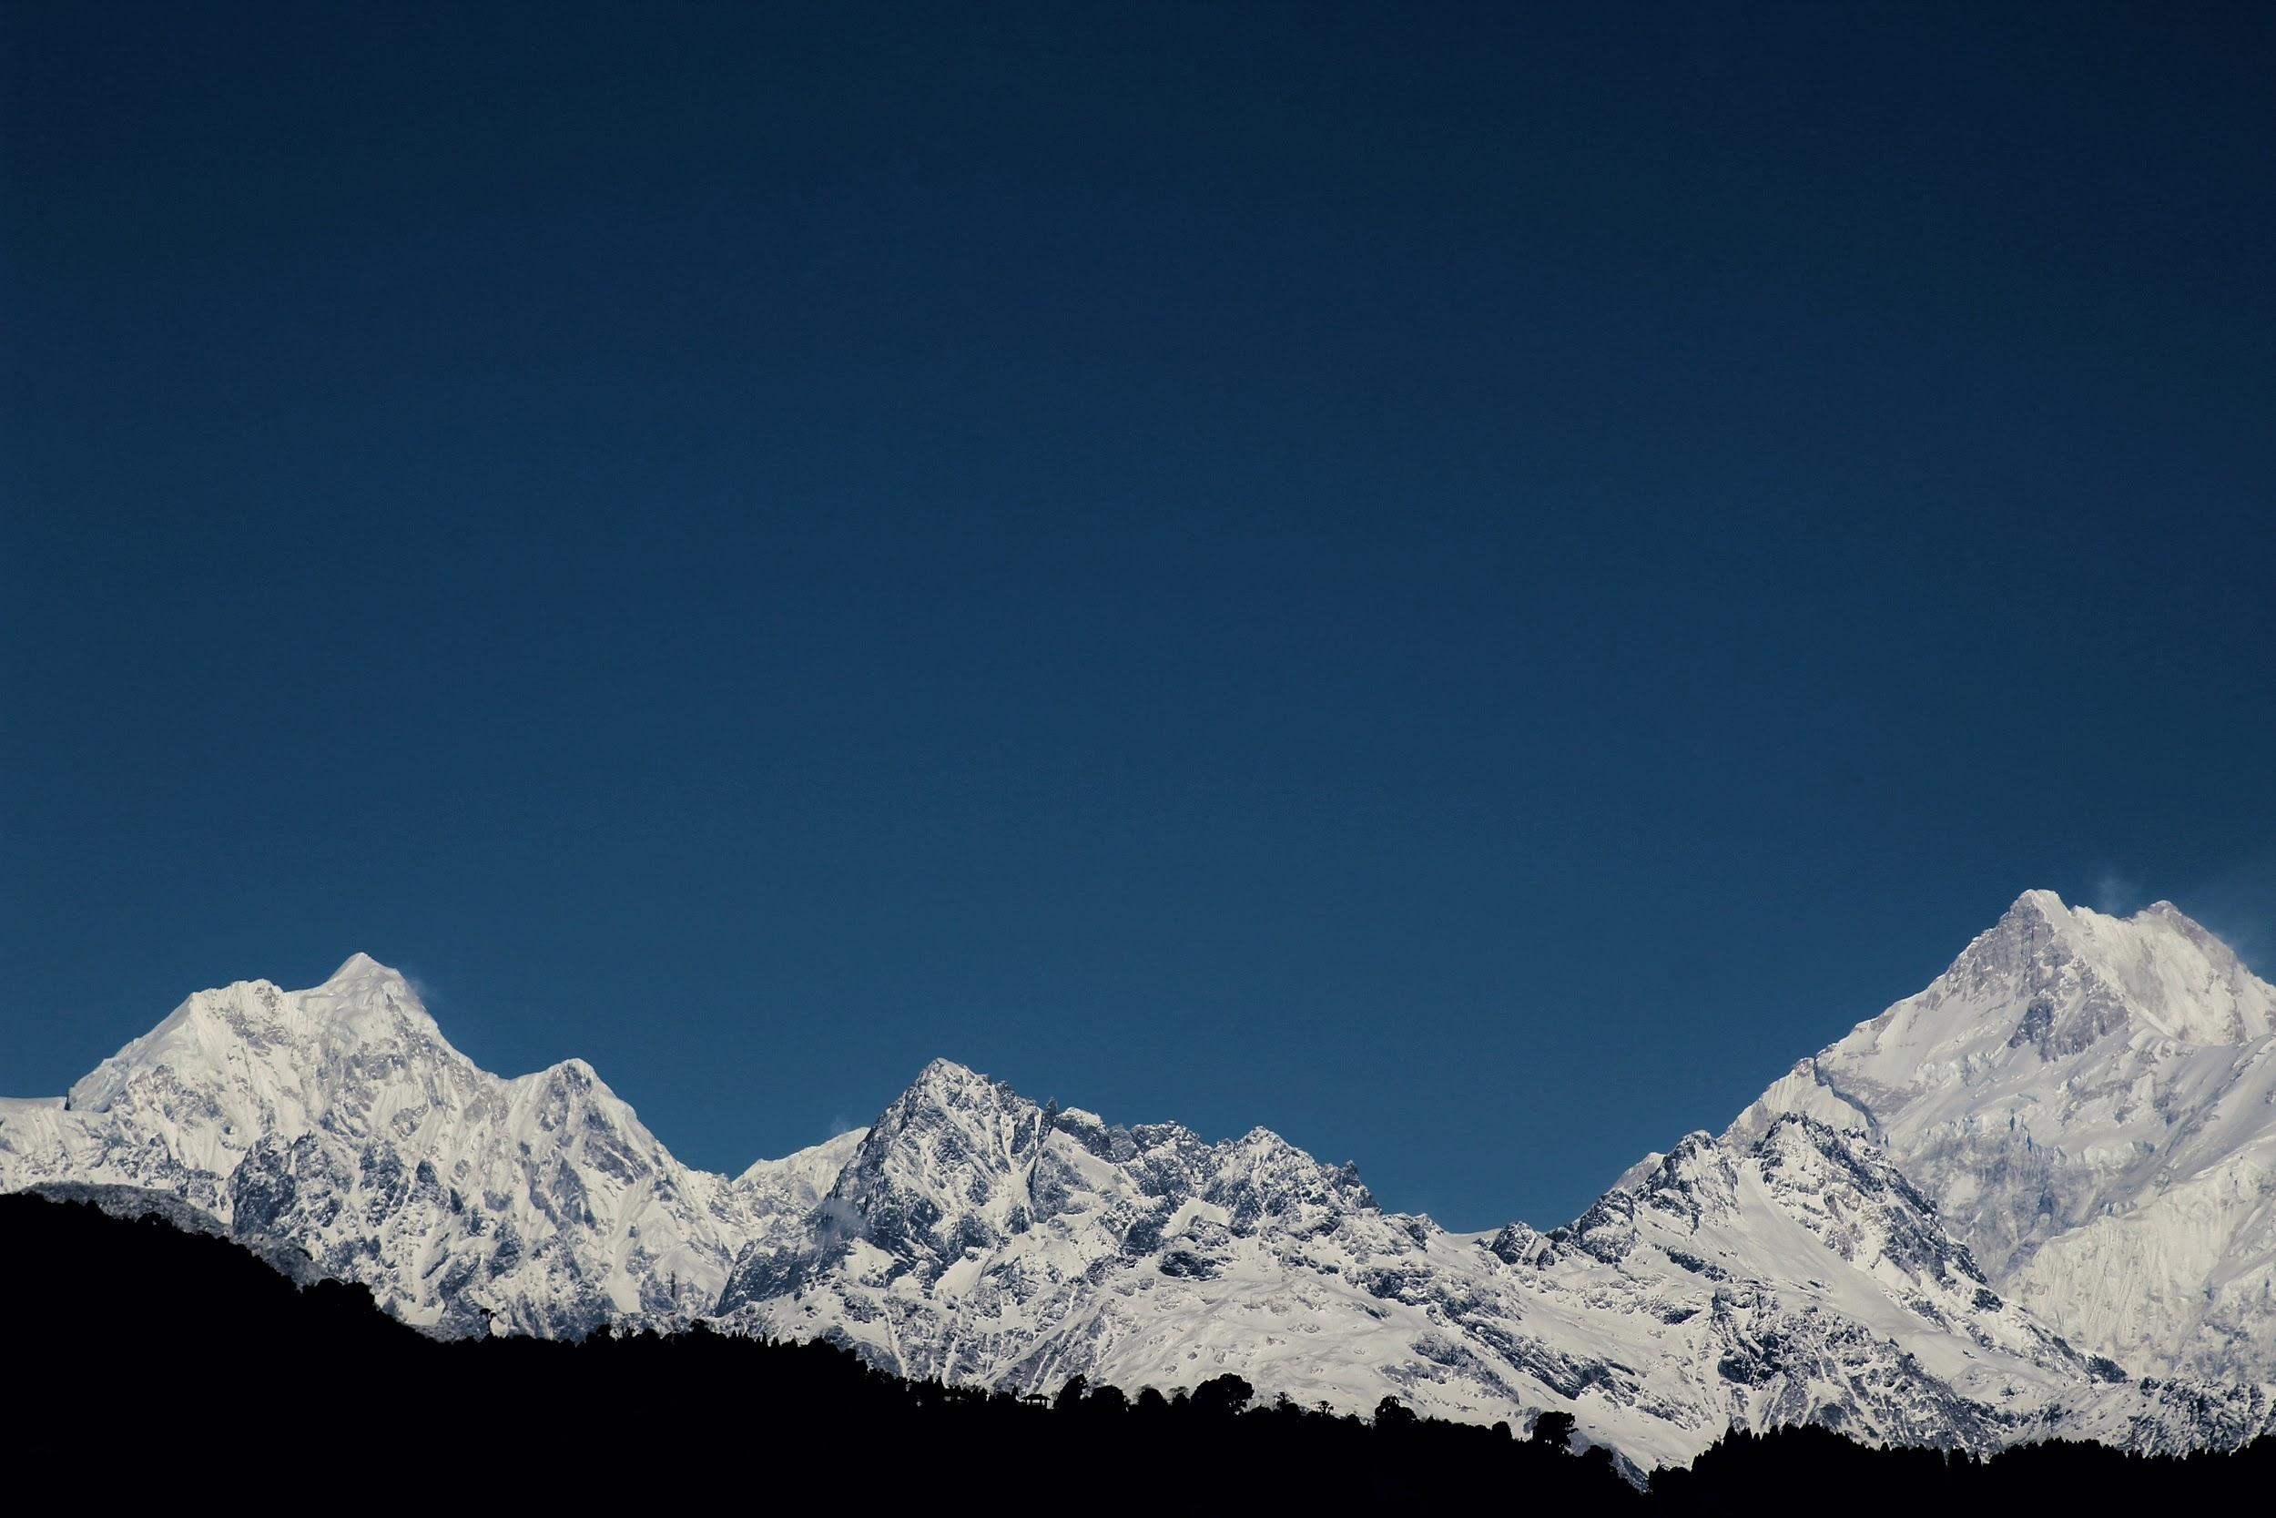
Big Mountain Resort
Case Study by Jessica Lewis

Slide 2
Initial Request
Increase revenue
Specifically:
Cover the running cost of a new set of lifts: $1,540,000 for the season
Identify any potential for a ticket price increase
Consider 4 investment scenarios to justify a ticket price increase

Slide 3

The Big Question
How can Big Mountain Resort optimize their facilities in order to justify an increase in ticket price to cover the running cost of their new lift ($1,540,000 for the season)?

Slide 4

Recommendation
Ticket Price Increase: $6.50
$4.48 base + $1.99 Scenario 2, then a tiny round-up
Investment Scenario: 2 or 3
Add 1 run, increasing vertical drop by 150 ft
Instal an additional chairlift
Add 2 acres to snow making area (scenario 3 only)

Slide 5
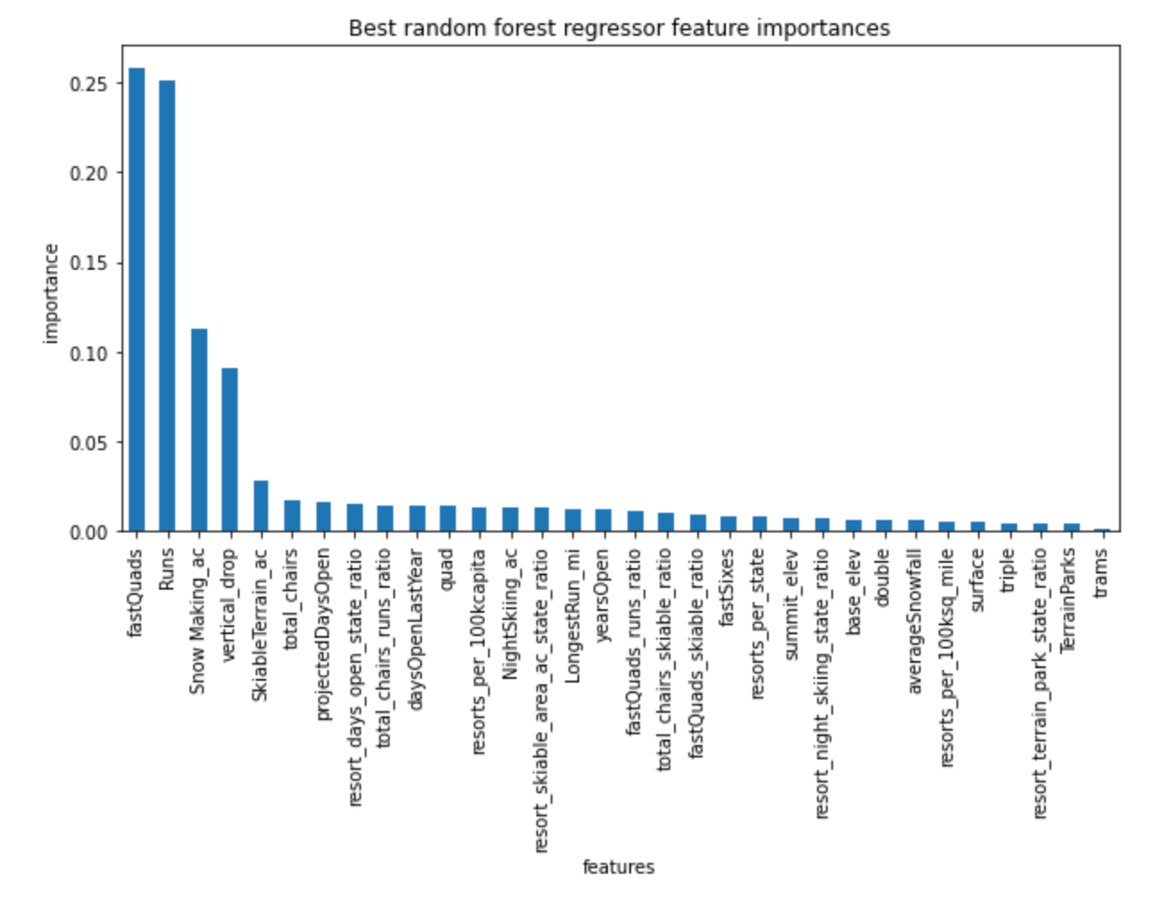
Not all features are equal
After training our model, and comparing each feature’s effect on ticket price, we see that 4 features stand out:
Number of fast quad lifts
Total number of runs
Vertical drop
Area of snowmaking
These are the features that our model will focus on from here on out.

Slide 6
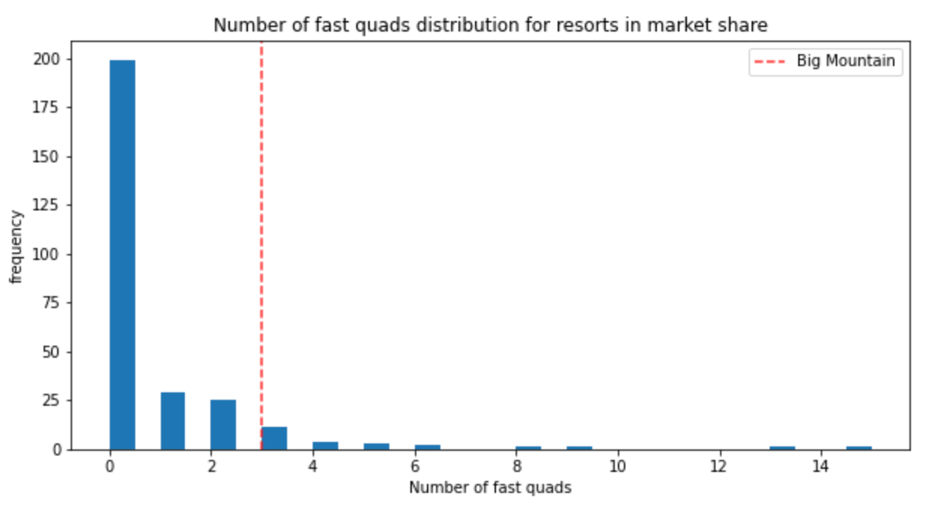
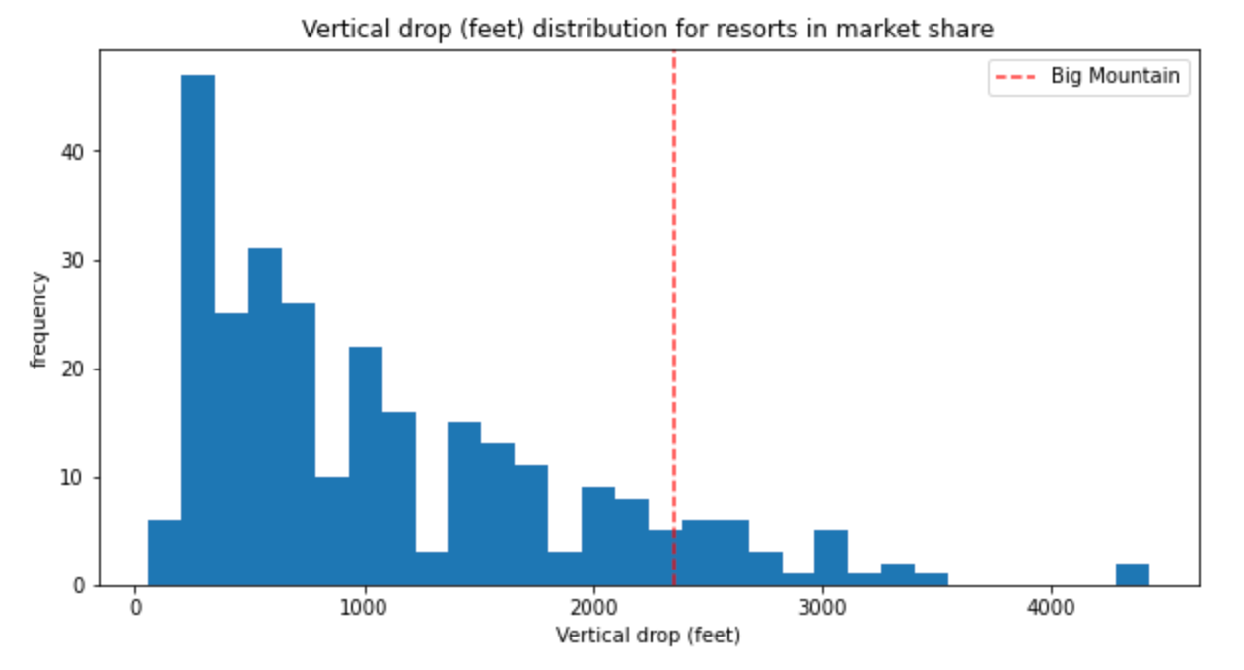
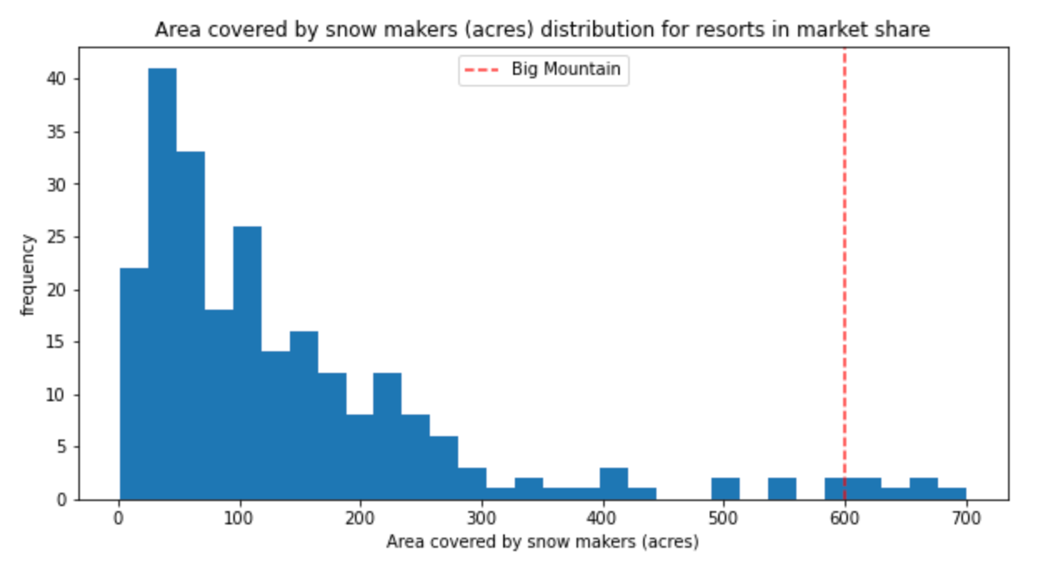
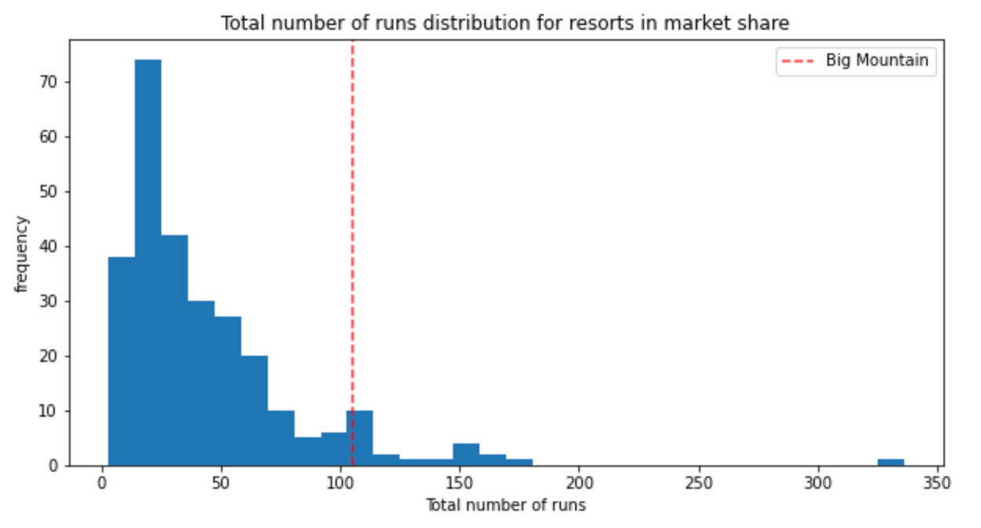
How does Big Mountain compare?

Slide 7
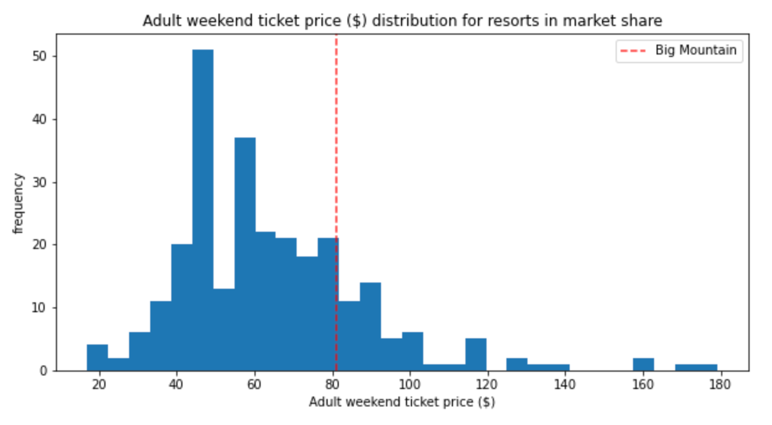
Ticket Price Analysis
Big Mountain Resort is priced above average, but not at the top of the field.
BMR is not priced proportionately, considering how highly they rated in the important resort features, suggesting that there is room to increase.

Slide 8
Confirmed.
Our model predicts Big Mountain’s ticket price to be $95.87, $14.87 above the current price of $81. Factor in a margin of error of $10.39 and we can safely increase the ticket price by at least $4.48.
Note: Because our model is using data by other resorts, and we cannot assume that those resorts have optimized their own prices, this recommendation for ticket price is an estimate.

Slide 9
What about the investment options?
Scenario 1: Close up to 10 runs. Not viable: the model indicated a drop in ticket price.
Scenario 2: Add a new run, which increases the vertical drop by 150 ft, and installing a new chair lift. Viable: model returned a ticket price increase of $1.99
Scenario 3: Add a new run, which increases the vertical drop by 150 ft, and installing a new chair lift. Plus adding 2 acres of snowmaking. Viable: model returned a ticket price increase of $1.99. *Adding 2 acres of snowmaking didn’t make a difference in ticket price, but it was a big factor in determining it; it’s possible doing this can bring in additional visitors per season.
Scenario 4: Increase the longest run by 0.2 mile to boast 3.5 miles length, requiring an additional snow making coverage of 4 acres. Not viable: no difference in ticket price.

Slide 10
Does the ticket price increase cover the new chairlifts?
Yes.
Based on a seasonal visitor total of 350,000 and an average length of stay of 5 days, only an $.88 increase in ticket price is required to cover the cost of a new lift.
Increasing the ticket price by $4.48 would increase revenue by $7,840,000 per season. Deducting the running cost of the new lift, Big Mountain would still see an increase in profits of $6,300,000 per season.
Assuming the chair lift proposed in Scenarios 2 and 3 have the same running cost, upping the ticket price by the additional $1.99 would still show profits of $1,942,500.

Slide 11
Conclusion
Big Mountain Resort should increase their ticket price from $81 to $87.50 and invest in proposed scenario 2 or 3.

